Slide 1
Marketing

Slide 2

Understanding the terms Need, Wants demand and desire

Slide 3

Demand
Demand is the consumer’s desire to purchase a particular good or service. Market demand refers to the total quantity of a product or service that consumers are willing and able to purchase at a given price within a specific market. It represents the collective desire and purchasing power of all potential customers.
This is determined by how willing consumers are to spend a certain price on a particular good or service. As market demand increases, so does price. When the demand decreases, price will go down as well.

Slide 4
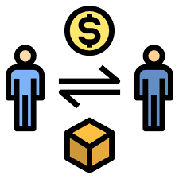
TYPES OF Demand

Slide 5
Type of Demand | Situation | Approach
Negative Demand | Consumers actively dislike or avoid a product or service. | Focus on product improvements, rebranding, or effective communication of benefits.
Nonexistent Demand | There is little to no awareness or interest in the product or service. | Create awareness and generate interest through compelling value propositions and promotions.
Latent Demand | Consumers have an underlying need but may not be aware of a specific solution. | Identify the latent needs and educate consumers on how your offering can address their unmet needs.
Declining Demand | Demand for a product or service is decreasing over time. | Investigate the reasons behind the decline and focus on product innovation or diversification to revitalize interest.
Irregular Demand | Demand fluctuates unpredictably, often due to seasonal factors or external events. | Implement flexible pricing strategies, plan effective marketing campaign. Promotions and discounts during peak demand periods
Full Demand | Demand matches or exceeds the available supply. | Maintain quality and customer satisfaction. Explore opportunities to upsell or cross-sell to existing customers.
Overfull Demand | Demand exceeds the available supply, leading to shortages. | Increase production capacity, manage customer expectations transparently

Slide 6
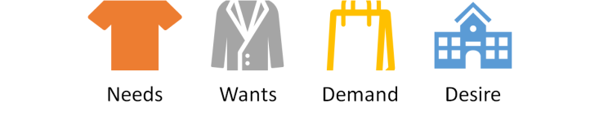
In a nutshell
Needs: Needs are the basic requirements for human survival such as food, shelter, and clothing. They are considered a primary motivator for consumers as they are essential to sustain life.
Wants: Wants are desires or aspirations that go beyond basic human needs. For example, a person may need food to survive, but they may want a specific type of food or brand. Wants are often influenced by social and cultural factors and can vary greatly from person to person.
Demands: Demands refer to the willingness and ability of customers to purchase a product or service. It represents the economic desire for a product or service backed by the ability to pay for it.
Desires: Desires are strong wishes or wants that often arise from the social or cultural context of an individual. They may not be essential, but they are compelling motivators for consumption.

Slide 7
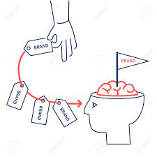
Customer driven marketing strategy
“Customer-driven marketing is a marketing approach that focuses on building strong, positive relationships with existing customers. By identifying your target market, meeting the needs of your customers, and ensuring they are satisfied with their experience at every touch point, your company will become a magnet for new prospects and returning customers”.

Slide 8
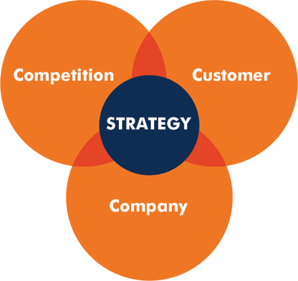
The three C's
Customers, Competition and Company
are essential to creating a marketing strategy that will resonate with your target audience, differentiate your offerings from your competition, and effectively communicate your brand's value.

